Slide 1
New York Uber Trips
File created on: 2020-11-07 10:24:42 AM

Slide 2
Target Users and Benefits
Uber
Uber customers
Other taxi services
Reduce surge pricing
Maximize capacity and Utilize resources
Arrangement guidance

Slide 3
Data Source
Uber trips
Weather data

Slide 4
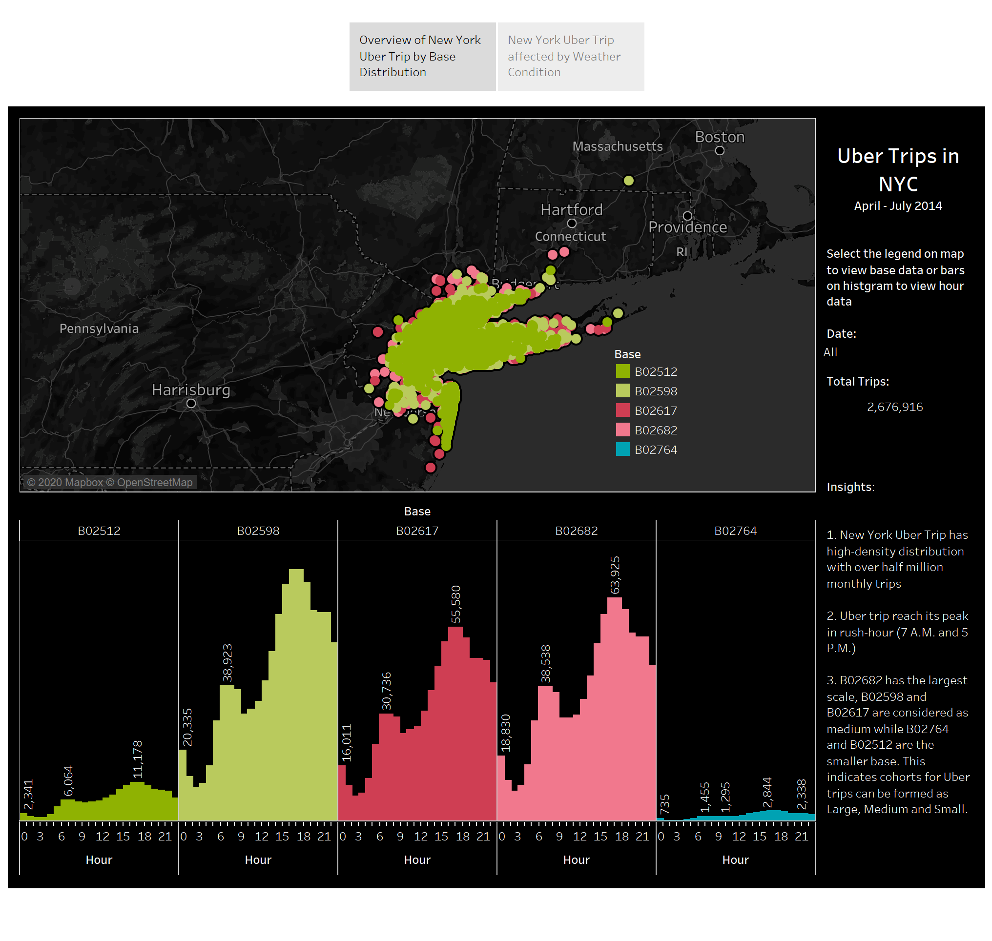

Slide 5
